Slide 1


MAY 2019
EFFICIENT DATA PARTITIONING FOR NEURAL NETWORKS
SaURABH GUPTA, AJAY KRISHNA ANANDA KUMAR, RESHMA RAJARAMA NAYAK

Slide 2
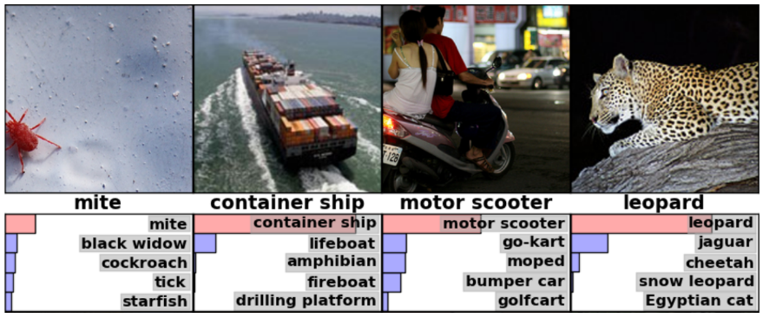
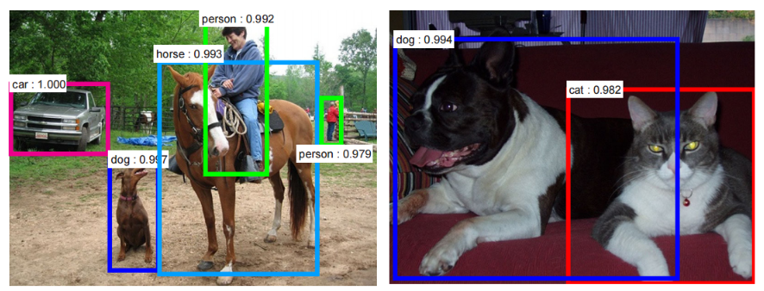
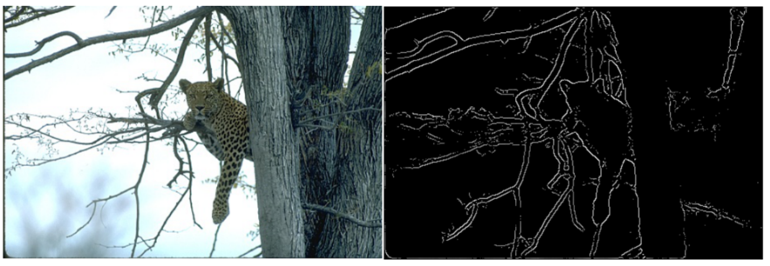
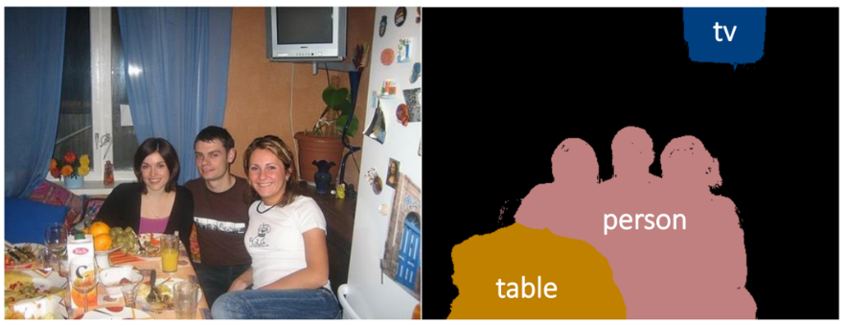
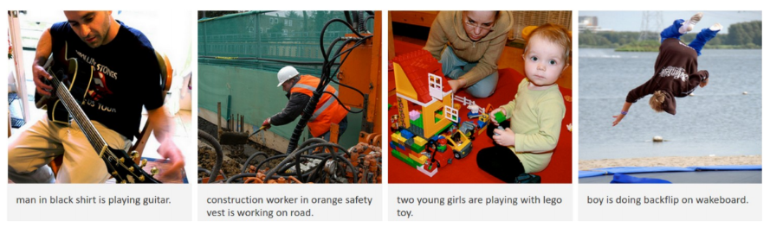
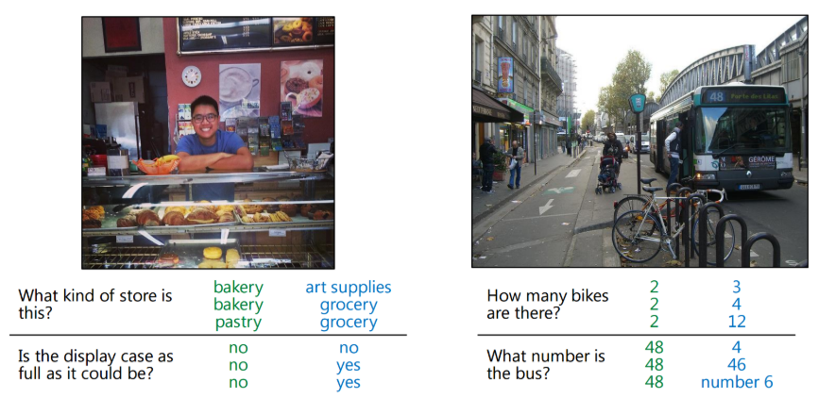
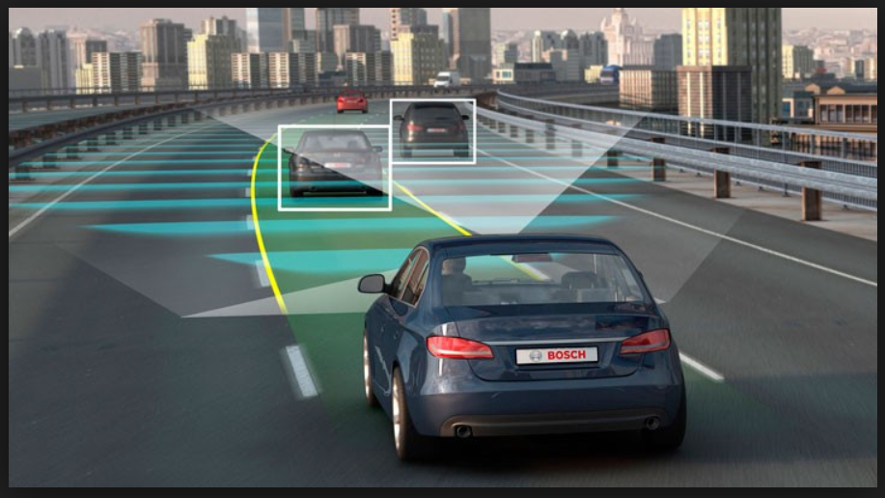

Deep Neural Networks is ubiquitous!

Slide 3
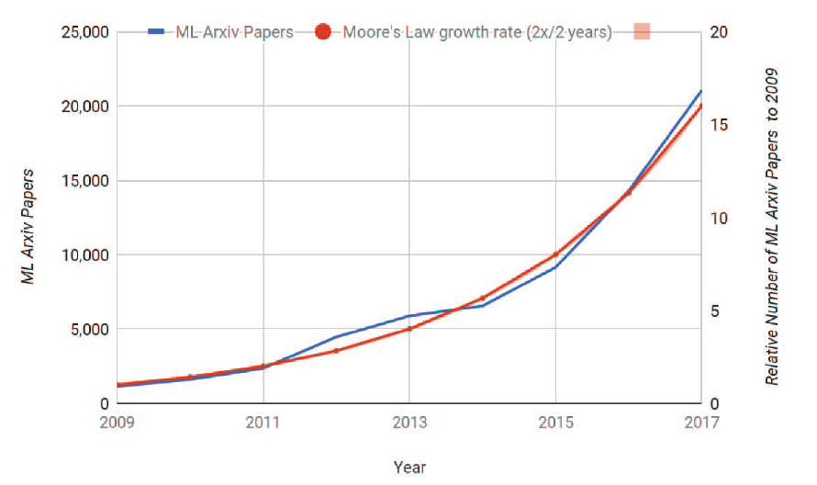
Deep Learning – Active Research area
Graph source : Dean, Jeff, David Patterson, and Cliff Young. "A new golden age in computer architecture: Empowering the machine-learning revolution." IEEE Micro 38.2 (2018): 21-29.

Slide 4
Neural network
Driving factors for neural network optimization:
Large models
Huge data processing
Key efficiency metrics:
Compute:
Parallelization to achieve efficient performance gain
Memory:
Reduce communication and synchronization overhead

Slide 5
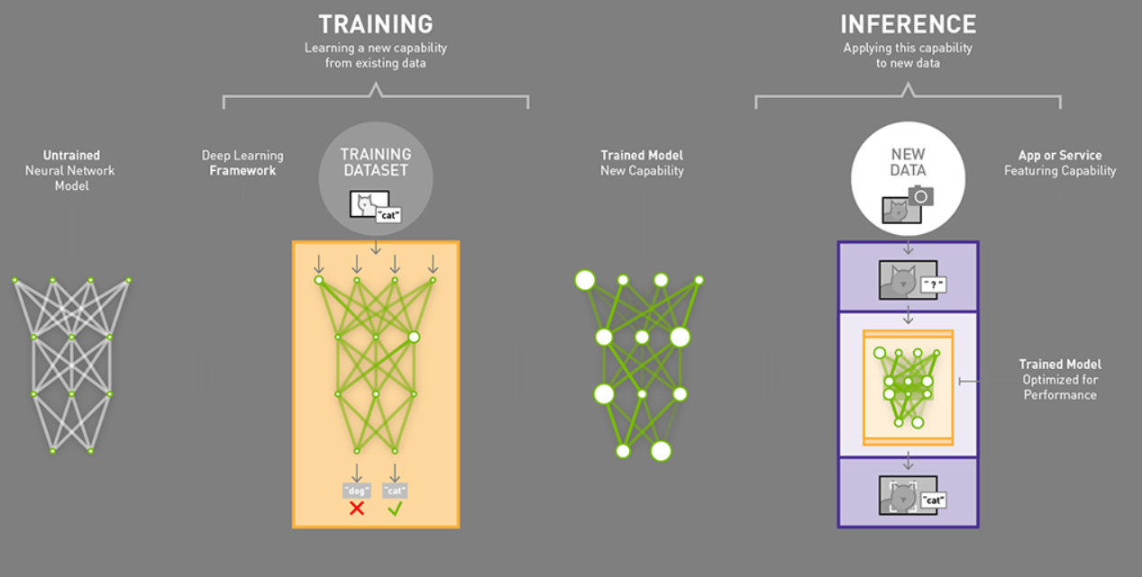
Training vs Inference
Training is more challenging
Roughly 3 times more computations
Increased storage requirements
Large DNN models and Datasets
Image Source: https://blogs.nvidia.com/blog/2016/08/22/difference-deep-learning-training-inference-ai/

Slide 6
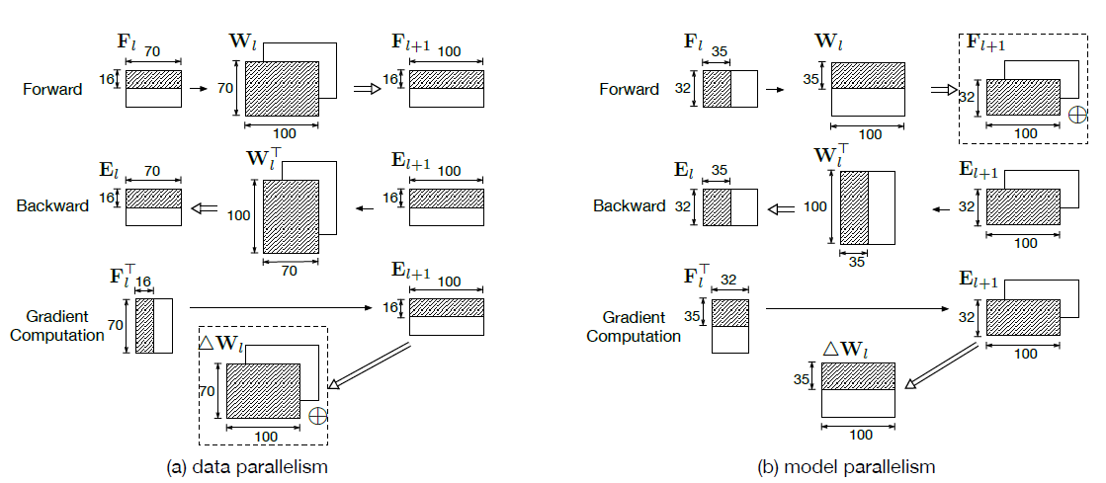
Partitioning - Data and Model parallelism
Data parallelism
Each sample is independent (S).
Divide image samples among the processing units.
Model parallelism
Each output channel is independent (M).
Divide CNN model (weights) among the processing units.

Slide 7
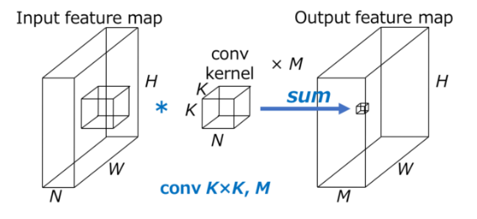
Convolutional Neural Networks
Input feature map: H*W*N
Output feature map: H*W*M
Weight parameters: K²*N
Number of computations:
H*W*N*K^{2*}M
For K=5, H=W=32*32, N=128, M=128
We need 80*10⁶ operations
Basic Convolution block

Slide 8
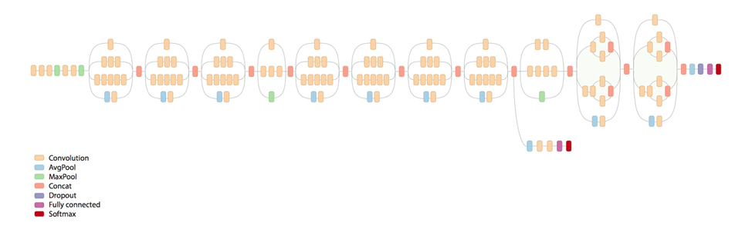
A typical Convolutional Network
There are ~10s-100s of these convolutional block

Slide 9
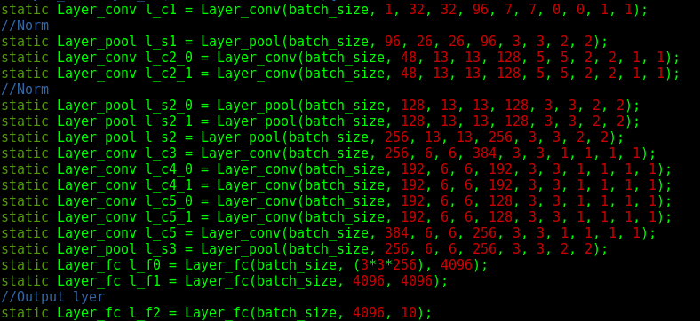
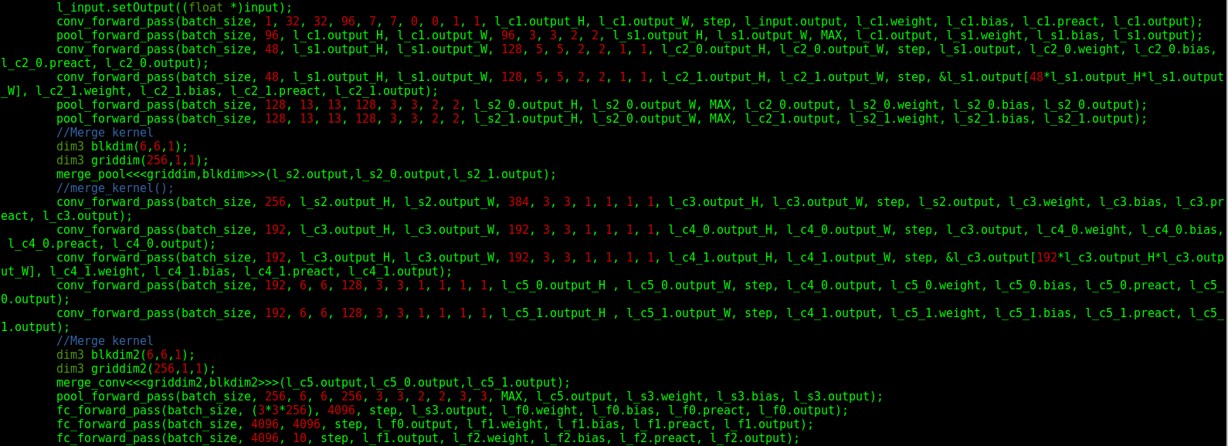
Implementation
CUDA primitives developed
Supports data and model parallelism flavors for Convolutional, average and max pooling, fully connected layers
Chooses configurations for kernel launch based on the tensors dimensions and batch size
Supports logistic and RELU activations

Slide 10
Implementation
Developed three CNN architectures : Lenet-5, AlexNet, ResNet-18
CUDA kernel for fused Convolutional layer : forward and backward input gradient propagation supporting different data layout.
Explored three different GPU architectures and their performance implications
Multi-GPU implementation of AlexNet and communication overhead analysis on 2 and 4 GPUs

Slide 11
Machine configurations
Property | Tesla K40s | GeForce GTX 1080 Ti | Tesla P100-PCIE-16GB
CUDA Compute capability | 3.5 | 6.1 | 6
Number of SMs | 15 | 28 | 56
Total amount of global memory | 11440 MBytes | 11178 MBytes | 16281 Mbytes
CUDA Cores | 2880 CUDA Cores | 3584 CUDA Cores | 3584 CUDA Cores
GPU Max Clock rate | 745 MHz (0.75 GHz) | 1582 MHz (1.58 GHz) | 1329 MHz (1.33 GHz)
Memory Clock rate | 3004 Mhz | 5505 Mhz | 715 Mhz
Memory Bus Width | 384-bit | 352-bit | 4096-bit
L2 Cache Size | 1572864 bytes | 2883584 bytes | 4194304 bytes
Total amount of shared memory per block | 49152 bytes | 49152 bytes | 49152 bytes

Slide 12
CNN architectures
Parameters and computation comparisons:
Neural Network Architecture | Number of Params | Number of computation (FLOPs)
Lenet-5 | 60840 | 3.41x10⁵
AlexNet* | 28567498 | 1.08x10⁸
Resnet-18* | 10862986 | 1.13x10⁷

Slide 13
CNN - Parameters
Input feature map: Inp[N][C][H][W]
Output feature map: Out[N][M][H’][W’]
Kernel Map: Wi[M][C][K][K]
Where:
‘N’ is the batch size
‘C’ and ‘M’ are number of input and output channels respectively.
‘H’ and ‘W’ are input feature dimension
H’ and W’ are output feature dimension (depending on ‘K’, stride and padding)

Slide 14
RESULTS

Slide 15
Data Parallel
Occupy GPU by providing more training samples (batch).
Different SMs work on different samples.
Pros:
More work for GPU to occupy it’s resources.
Cons:
Higher memory footprint.

Slide 16
Data Parallel – uArch considerations
Used K40, GTX 1080Ti and P100 GPUs.
K40 gets occupied only after batch size of 16, whereas 1080 Ti & P100 take 32 and 64 batch size respectively.
Even further batch size required to hide the latency

Slide 17
Model Parallel
Different SMs work on different channel.
Pros:
Smaller weight matrix can be stored locally in shared memory.
Reduced global memory traffic.
Cons:
Unable to fully occupy GPU.
Defined by DNN architecture, not configurable.

Slide 18
Model Parallel - Comparison
Performance falls short of data parallel approach when the data parallel batch size is increased.
Explanation: The data parallel execution time decreases sub-linearly with batch size.

Slide 19
Model Parallel - Comparison
Execution Time vs Batch size studied on 3 different GPU architectures

Slide 20
Model Parallel – uArch considerations
See similar trends as Data parallel approach.
Significant number of channels required to occupy the GPU.

Slide 21
Hybrid Approach
Divide both batch size and number of output channels.
Takes advantage of data locality of model parallelism and sub-linear scaling of data parallelism with batch size.
Saturates with much smaller batch size. Thus, lesser memory footprint.

Slide 22
Hybrid Approach
GTX 1080Ti and P100 show similar trend.
K40 and GTX reach data parallel saturation at batch size of 64 but P100 reaches saturation at 128.
Irrespective of DNN and underlying machine architecture, hybrid approach performs better.

Slide 23
Comparison of schemes for other networks
The crossover point of AlexNet and Resnet is around 64 batch size, but Lenet has early crossover, due to the dimensional channels of the former CNN architectures.

Slide 24
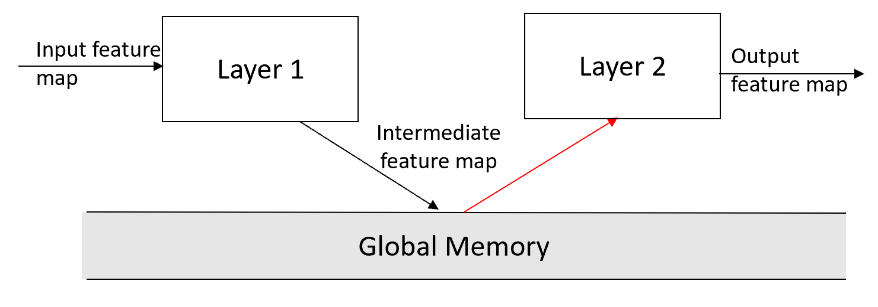
Layer Fusion
Even with above optimizations, each layer has to store data and next layer has to load it back.
We can further reduce memory dependency by storing intermediate results locally.
Possible by partitioning input feature space.

Slide 25
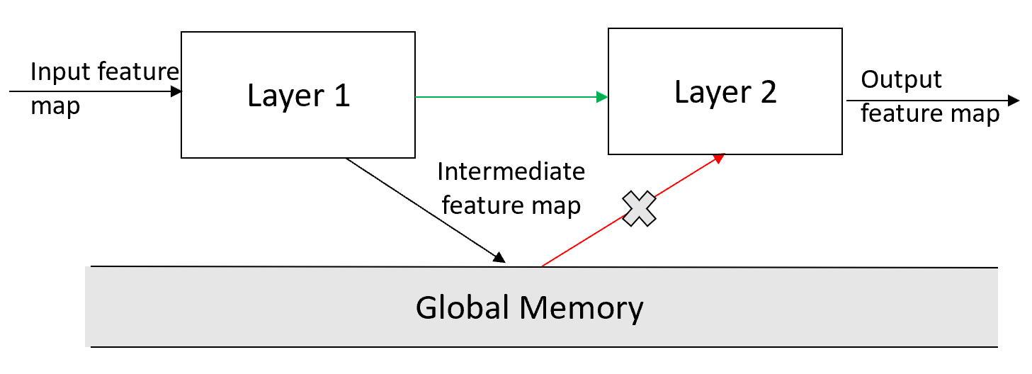
Layer Fusion
Even with above optimizations, each layer has to store data and next layer has to load it back.
We can further reduce memory dependency by storing intermediate results locally.
Possible by partitioning input feature space.

Slide 26
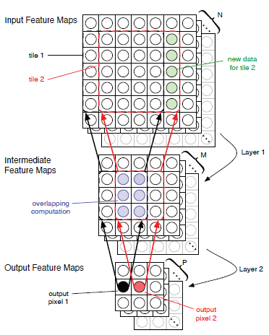
Layer Fusion
A bigger tile in Layer 1 serves a smaller tile in Layer 2 to produce a smaller tile of output feature.
Cause re-computations due to tile overlap
Constraints:
Intermediate tile should be small enough to fit in shared memory.
Data locality befit should outweigh the amount of re-computations.

Slide 27
Layer Fusion
Counter intuitively, the execution time increase with the fused implementation.
Explanation: Tiling looses the spatial locality in the input feature space.
Thus, even the layer 1 computation time increases by ~6x.

Slide 28
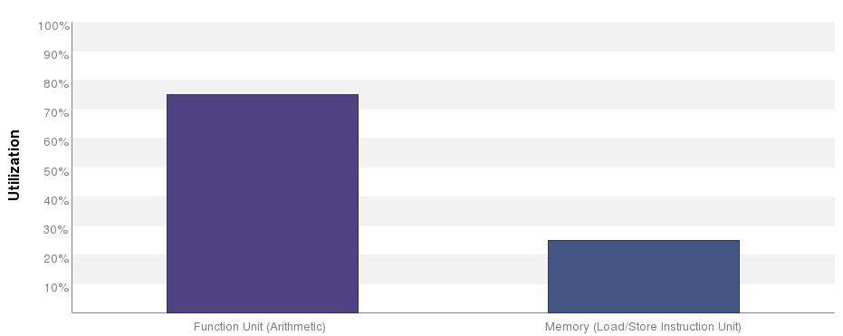
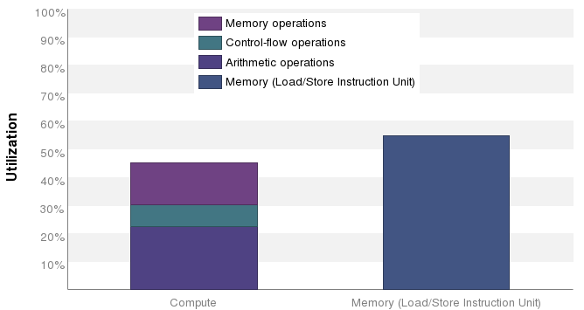
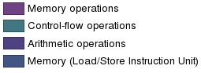
Layer Fusion – Memory dependency
The compute utilization is pretty low for the fused implementation
Regular
Fused

Slide 29
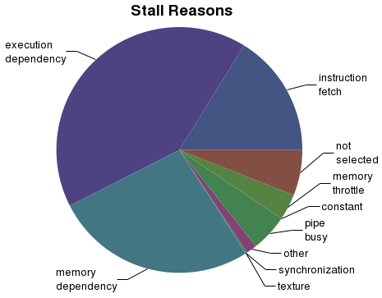
Layer Fusion
The memory dependency causes a significant stall in the progress. (~27%).
Effective memory bandwidth too reduces from 340 GB/s in regular approach to 260 GB/s in fused approach.

Slide 30
Layer Fusion – Move to NHWC
In regular approach, the input feature map is stored as ‘NCHW’.
Since image dimension (‘H’ & ‘W’) are the lower dimensions, tiling causes this dimension to shrink.
NHWC approach on the other hand changes the lowest dimension as number of channels.
With minor changes in computation pattern, this storage enhances coalesced accesses.

Slide 31
Layer Fusion - NHWC
Obtain much superior results with ‘NHWC’ based feature storage over the ‘NCHW’ storage.
Achieve ~2x speedup of second layer over the non-fused version and achieves ~15% speedup overall.

Slide 32
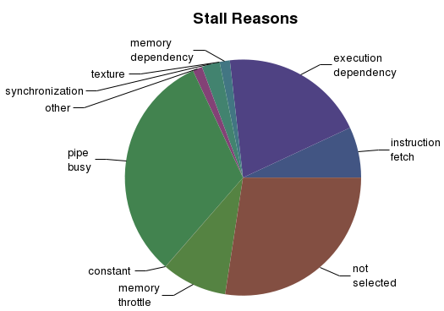
Layer Fusion - NHWC
The memory dependency with NHWC approach is reduced to <5%.
Effective memory bandwidth increased from 340 GB/s in regular approach to 729.448 GB/s (>~2x) with this NHWC fusion approach.

Slide 33
Layer Fusion – GTX 1080 Ti
On GTX, the fused layer achieves ~5x speed up over first layer and ~35% speed up overall.
The layer 1 compute time is still higher due to the re-computations in fused implementation.

Slide 34
Layer Fusion – Analytical Model
We developed an analytical model to calculate additional computations and when this tile based approach is effective.
Say, we have ‘SHRD’ amount of shared memory.
Intermediate layer’s tile can be only as big as to fit in this shared memory.
For ‘M’ output channels in intermediate layer:
SHRD = S²*M*4
‘SxS’ is the intermediate layer’s tile size
‘4’ to consider size of float.
‘M’ is the number of channels in intermediate layer.

Slide 35
Layer Fusion – Analytical Model
Considering, kernel for both layers is of dimension [M][M][K][K]
where both input and output number of channels is equal for keeping the overall calculation simple.
For ‘SxS’ intermediate layer tile, we get:
Tile size of input layer: S+K-1
Tile size of output layer: S-K+1
Considering stride of ‘1’ and padding to input and output feature map dimensions same.
The input, intermediate & output feature map will be of ‘MxH’x’W’ dimension.

Slide 36
Layer Fusion – Analytical Model
Thus number of computations
= No. of computation in a tile * number of tiles
No. of computation in a tile = K²C.M.S²
where K²C is the computation for a single convolution.
Same is done for ‘M’ number of channels.
And repeated for S² times i.e. number of elements in a single channel of intermediate layer.

Slide 37
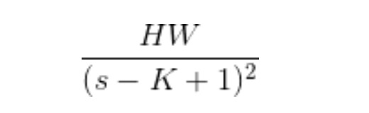
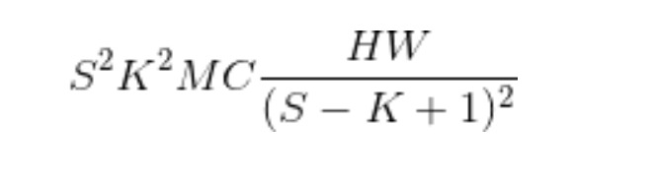
Layer Fusion – Analytical Model
Number of tiles =
Where (s – K + 1) is the output layer tile size.
Therefore, number of computations =
Computation in traditional convolution = K²MCHW

Slide 38
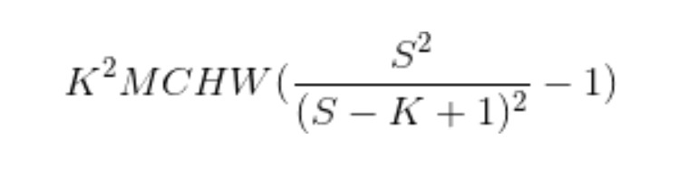
Layer Fusion – Analytical Model
Thus, number of re-computations =
As S>>K i.e. the intermediate tile size tends to be much higher than kernel size, the additional computation tends to 0.

Slide 39
Layer Fusion for gradient update
We applied the same fusion approach to back propagation gradient update.
The time increases in NHWC fusion based approach since the convolution is across the output channel rather than input channel which is the lowest dimension.
Thus, we have non-unit strided access to memory.

Slide 40
Layer Fusion for BP – transpose weight matrix
The problem can be solved by taking a transpose of weight matrix.
The transpose kernel time comes to 7us which is <0.1% of the actual gradient update time.
We again see ~2x speed up of the fused layer over the non-fused version and ~18% speed up overall.

Slide 41
Multi-GPU DNN training
Neural networks grow deeper for accuracy
e.g., Resnet-152, Inception-v3, Faster R-CNN
Large training dataset
e.g., ImageNet
Single GPU takes several days/weeks to train the network []
Multi-GPU necessary to achieve faster training.

Slide 42
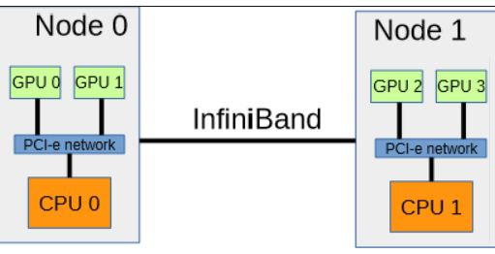
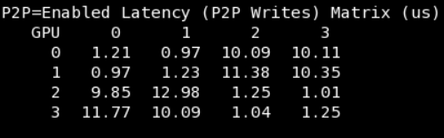
Multi-GPU training - Challenge
Communication and synchronization
Data parallel approach chosen for distribution of data (features and network model) among multiple GPUs as CNNs are main focus of this project.
Evaluation platform:
4 GTX 1080Ti connected to two NUMA nodes (2 GPUs/NUMA node)
GPU0 -> GPU1 – P2P access enabled
GPU0/1 -> GPU 2/3 – Resolves to normal memcpy procedure

Slide 43
Multi-GPU training - Analysis
AlexNet chosen as evaluation platform as it contains most of the commonly used layers covering reasonable configuration ranges
Communication overhead on total training time vs Batch size
Increasing number of GPUs -> Increasing overhead; also involves communication between 2 NUMA nodes via SMP
Increasing batch size –> lower number of communication modules in an epoch

Slide 44
Multi-GPU training - Analysis
Convolutional layers – computation dominant; lower weight kernels
e.g., Conv2:
Weight_dim = ~72MB
Number of operations = 896M operations
Fully connected layers – weight_dim/(no of computations) ratio high
e.g., FC2:
Weight_dim = ~67MB
Number of operations = 33M operations

Slide 45
Multi-GPU training - Conclusions
Convolutional layer dominated by computation. Computation component scales better with newer architectures than communication component.
Communication component can be reduced by increasing the batch size.
Strong scaling -> Higher batch size affects accuracy for a given training problem for fixed number of epochs (or) needs more epochs
Intra-GPU hybrid approach for data split would result in enough GPU occupancy, allowing multi-GPU scaling with reasonable batch size.

Slide 46
References
L. Song, J. Mao, Y. Zhuo, X. Qian, H. Li, and Y. Chen, “Hypar: Towards hybrid parallelism for deep learning accelerator array,” in 25th IEEE HPCA 2019, Washington, DC, USA , 2019.
Y. Lecun, L. Bottou, Y. Bengio, and P. Haffner, “Gradient-based learning applied to document recognition,” in Proceedings of the IEEE, pp. 2278–2324, 1998.
K. He, X. Zhang, S. Ren, and J. Sun, “Deep residual learning for image recognition,” in 2016 IEEE Conference on Computer Vision and Pattern Recognition, CVPR 2016, Las Vegas, NV, USA, June 27-30, 2016 , pp. 770–778, 2016
A. Krizhevsky, I. Sutskever, and G. E. Hinton, “Imagenet classification with deep convolutional neural networks,” in Advances in NIPS 25 , pp. 1097–1105, Curran Associates, Inc., 2012.
A. Krizhevsky, “Learning multiple layers of features from tiny images,” Technical report., 2009.
M. Alwani, H. Chen, M. Ferdman, and P. Milder, “Fused-layer CNN accelerators,” in 49th Annual IEEE/ACM International Symposium on Microarchitecture (MICRO) , 2016.
Lym, Sangkug, Armand Behroozi, Wei Wen, Ge Li, Yongkee Kwon, and Mattan Erez. "Mini-batch Serialization: CNN Training with Inter-layer Data Reuse." arXiv preprint arXiv:1810.00307 (2018).
Jung, Daejin, Wonkyung Jung, Sunjung Lee, Wonjong Rhee, and Jung Ho Ahn. "Restructuring Batch Normalization to Accelerate CNN Training." arXiv preprint arXiv:1807.01702(2018)
https://github.com/catchchaos/CUDA-CNN
Yadan, Omry, Keith Adams, Yaniv Taigman, and Marc'Aurelio Ranzato. "Multi-gpu training of convnets." arXiv preprint arXiv:1312.5853 (2013).

